Slide 1
A Machine Learning-Optimized Reconfigurable Intelligent Surface for Robust THz Indoor Communications
PUTSHU LUNGHE Samuel, ISBAT University
Credo HOLIDAY, ISBAT University
Liesel ABIGAIL, ISBAT University

Slide 2
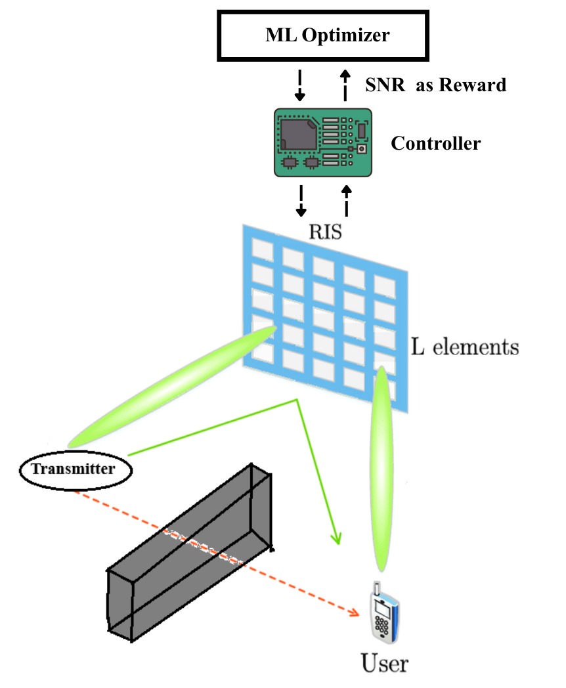
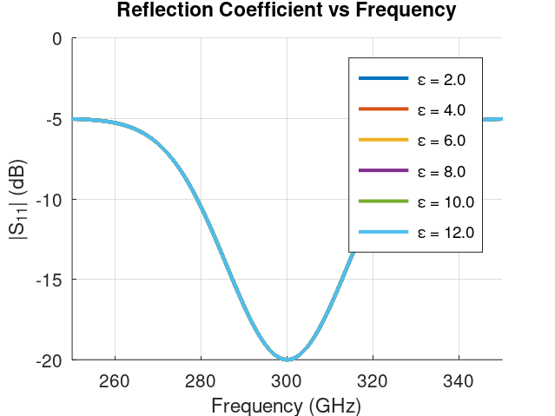
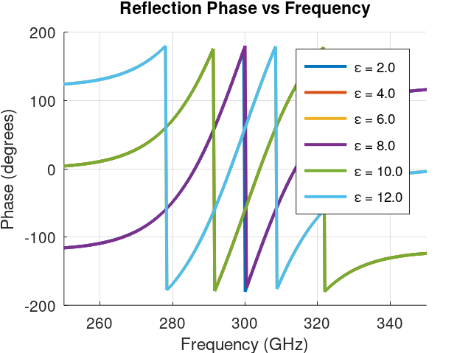
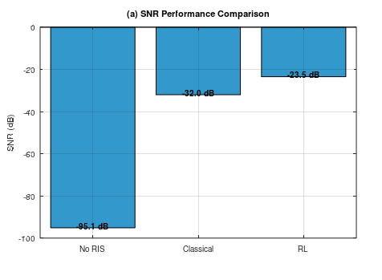
Phase 1: Meta-Atom Design
Phase 2: System Modeling & Optimization
Phase 3: Performance Analysis

Slide 3
References
M. A. ElMossallamy, H. Zhang, L. Song, K. G. Seddik, Z. Han and G. Y. Li, "Reconfigurable Intelligent Surfaces for Wireless Communications: Principles, Challenges, and Opportunities," in IEEE Transactions on Cognitive Communications and Networking, vol. 6, no. 3, pp. 990-1002, Sept. 2020, doi: 10.1109/TCCN.2020.2992604.
Yang, F., Pitchappa, P., & Wang, N. (2022). Terahertz Reconfigurable Intelligent Surfaces (RISs) for 6G Communication Links. Micromachines, 13(2), 285. https://doi.org/10.3390/mi13020285
Khaleel, S. A., Hamad, E. K. I., Parchin, N. O., & Saleh, M. B. (2023). Programmable Beam-Steering Capabilities Based on Graphene Plasmonic THz MIMO Antenna via Reconfigurable Intelligent Surfaces (RIS) for IoT Applications. Electronics, 12(1), 164. https://doi.org/10.3390/electronics12010164

